Slide 1
Week 4 Presentation
Group 1:
Jibin Mathews Maritza Torres

Slide 2
Objective
Make a course for the Lab 1 Group that is heavy on sensing and signaling.
Rover must complete the course in 60 seconds
Track Position of Rover and Determine speed required to finish on time
Course communication for various actions
IR and Sound

Slide 3
Deliverables
Track the color black (Works for example sheet to an extent)
Track Shapes (In Progress)

Slide 4
Track Elements
Utilize Metallic Strip as path for rover to follow
Use IR Sensor and Sound Communication to Decode/ Encode Information with Rover
Track Rovers location

Slide 5
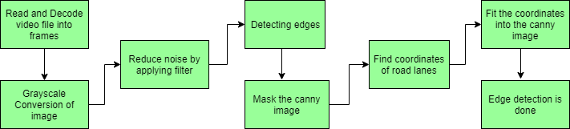
OpenCV Image Tracking Flowchart
(GeeksforGeeks, 2022)

Slide 6
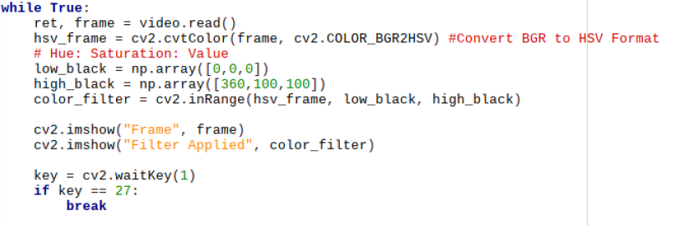
Detecting Black Circles on Opposite Backgrounds

Slide 7
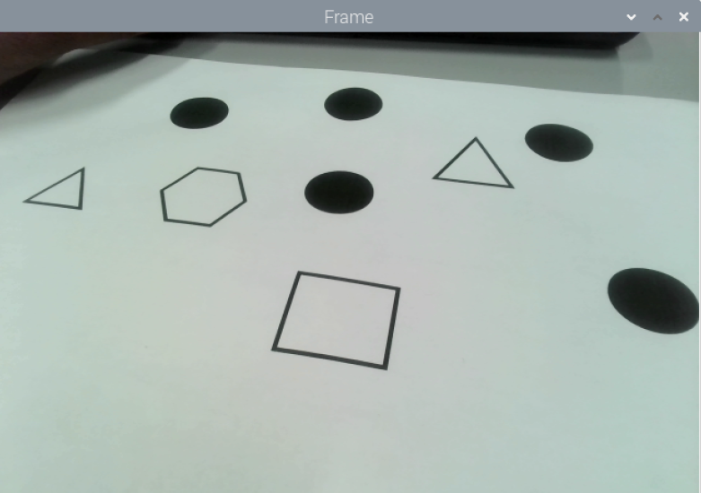

Detecting Black Circles on Opposite Backgrounds

Slide 8

Buzzer Test

Slide 9
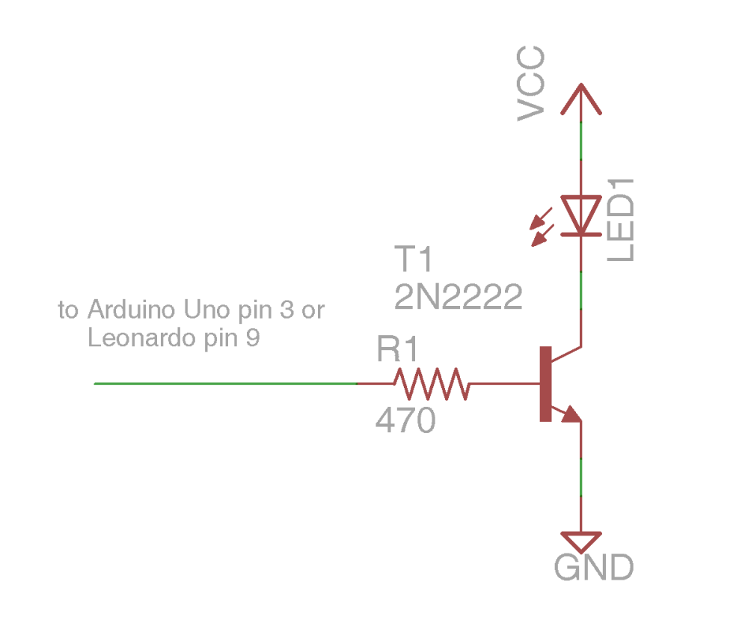
IR Sensor

Slide 10
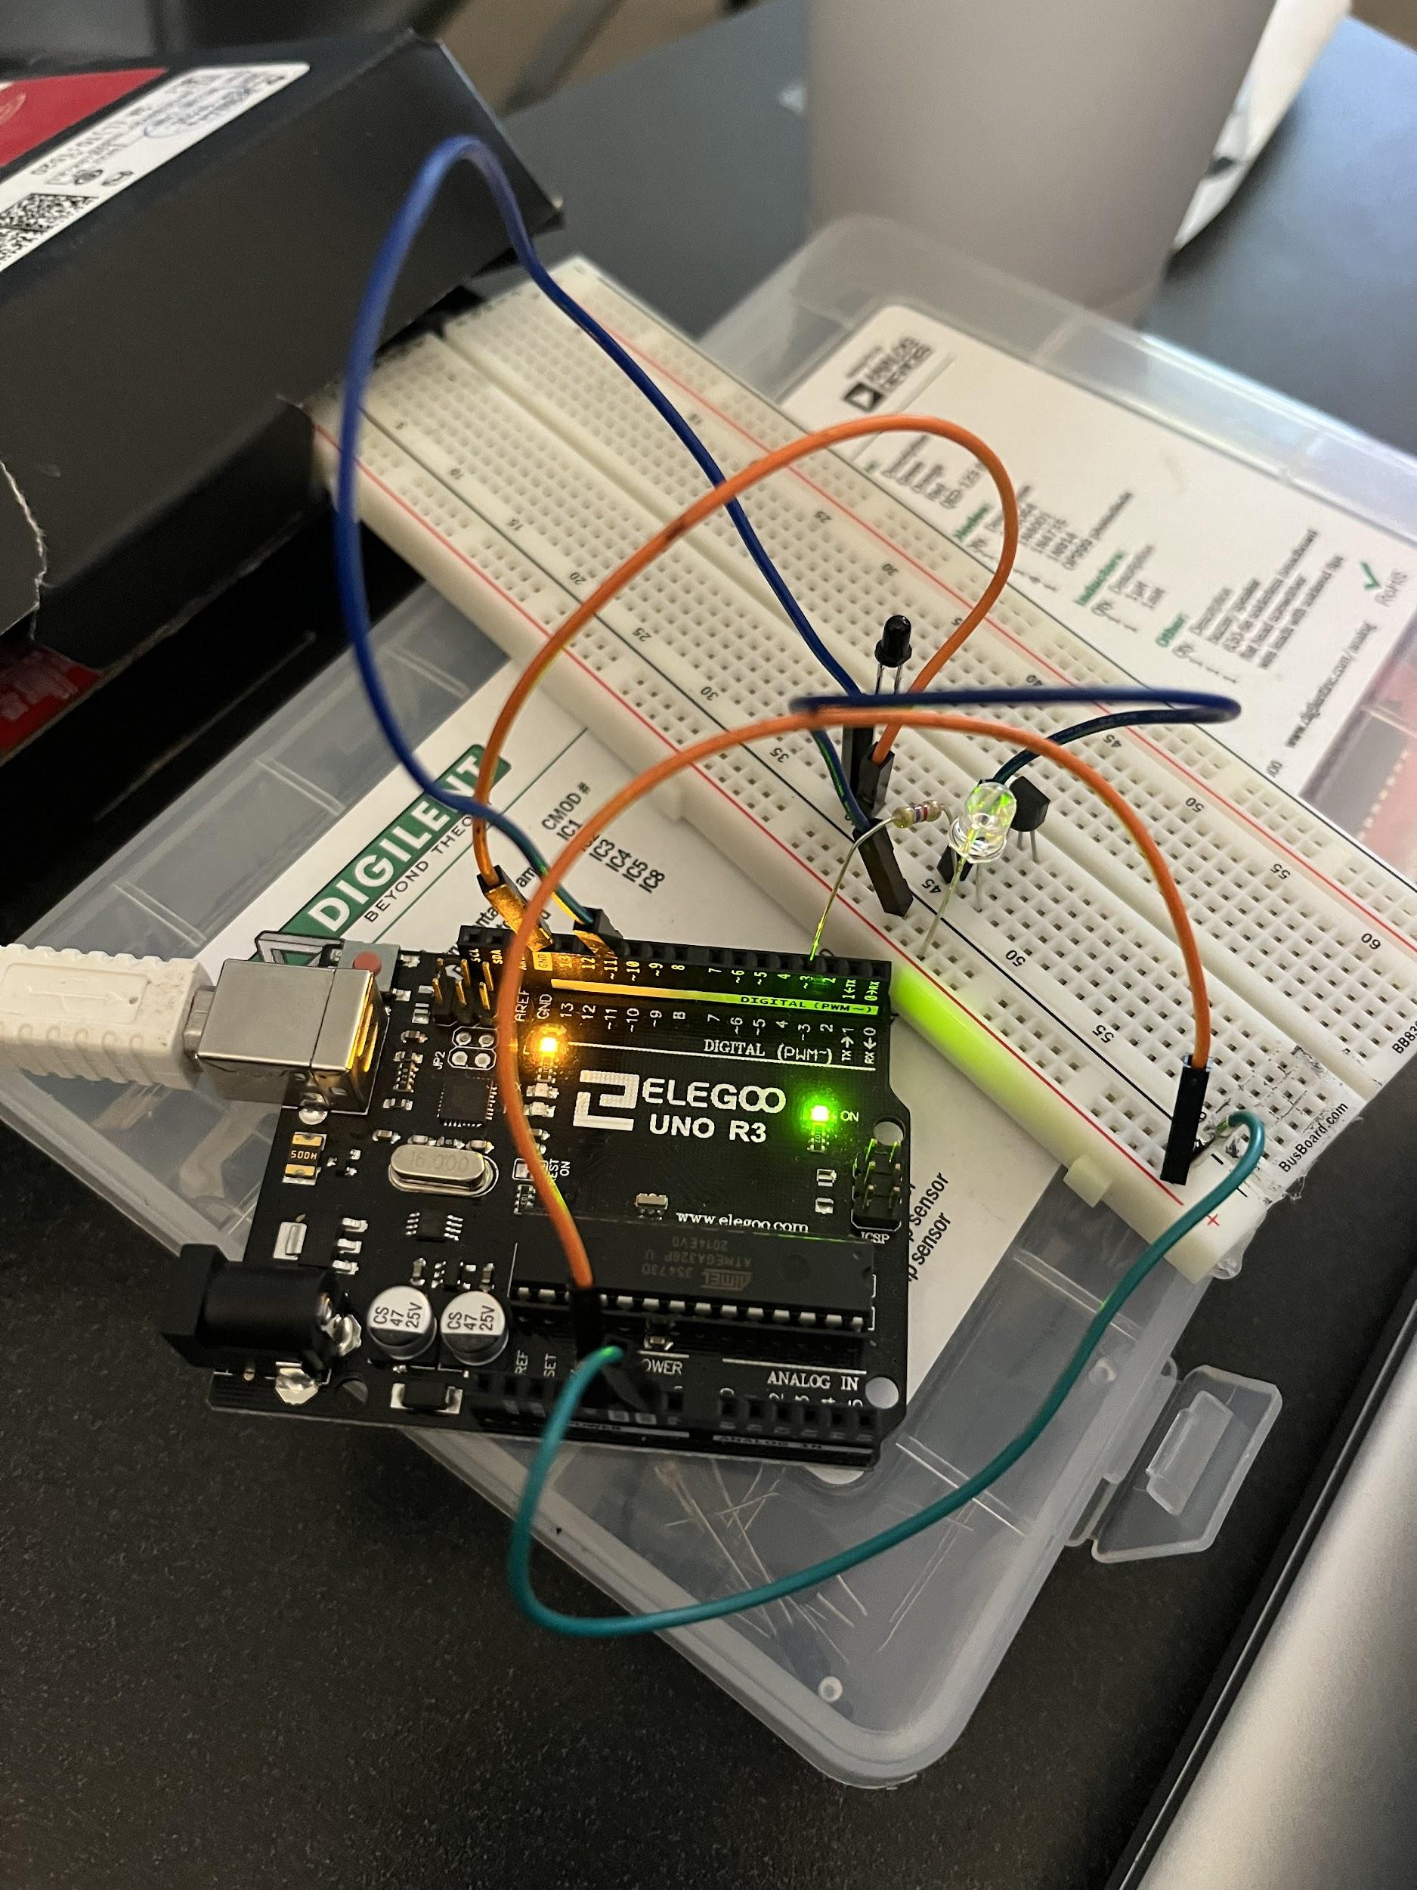
Hardware of IR sensor

Slide 11
Budget
Budget Lab 2 Project | Cost: | Total Spent:
Raspberry Pi 4 Model B | $129.99 | $0.00 |  | Material Costs | Cost: | Total Spent:
IR Receiver Module | $7.40 | $7.40 |  |  | $232.84 | $102.85
Misc. (LED, Resistors, Jumper wires) | $10.00 | $10.00
Onn. Webcam | $27.00 | $27.00 |  | Totals | Total Cost: | Actual Cost:
Elegoo Uno R3 (arduino) | $16.99 | $16.99 |  |  | $232.84 | $102.85
Buzzer | $1.04 | $1.04
USB Type B - A cable connector | $29.99 | $29.99
Breadboards | $9.99 | $9.99
2N9304 Transistor | $0.44 | $0.44

Slide 12
Gantt Chart
Lab 2 | Week 1 | Week 2 | Week 3 | Week 4 | Week 5 | Week 6 | Week 7
Hardware
Research
Path
Sensors
IR Receiver/ Transmitter
Buzzer
Object Tracking w/ Camera
Software
Research
Download/ Install: Python/ OpenCV
Actual Coding

Slide 13
Next Week's Deliverables
IR Transmitter Completed
Track Black Circles on Metallic Tape

Slide 14
References
OpenCV: Real time road lane detection. GeeksforGeeks. (2022, January 18). Retrieved June 28, 2022, from https://www.geeksforgeeks.org/opencv-real-time-road-lane-detection/
chrome-extension://efaidnbmnnnibpcajpcglclefindmkaj/https://www.aatc.tw/images/pdf/20200508291bd.pdf
https://www.aatc.tw/products.php?lang=en&id=635

Slide 15
Questions
?

